Slide 2


BREAKING the CURSE OF DIMENSIONALITY
ENGINEERING MACHINE LEARNING
HEALTH TECHNOLOGY

Slide 3
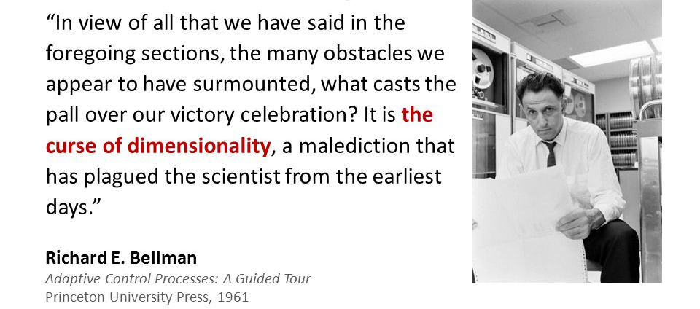
The curse of dimensionality
https://slideplayer.com/slide/4618284/

Slide 4
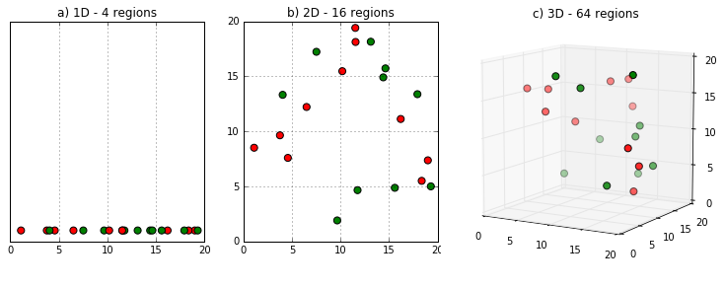
The curse of dimensionality

Slide 5
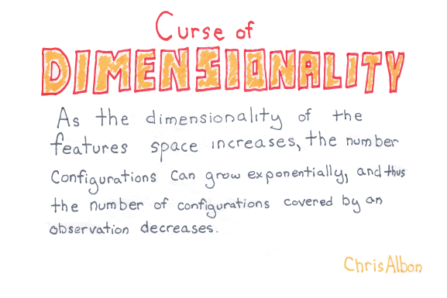
The curse of dimensionality

Slide 6
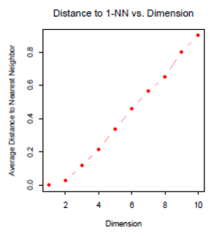
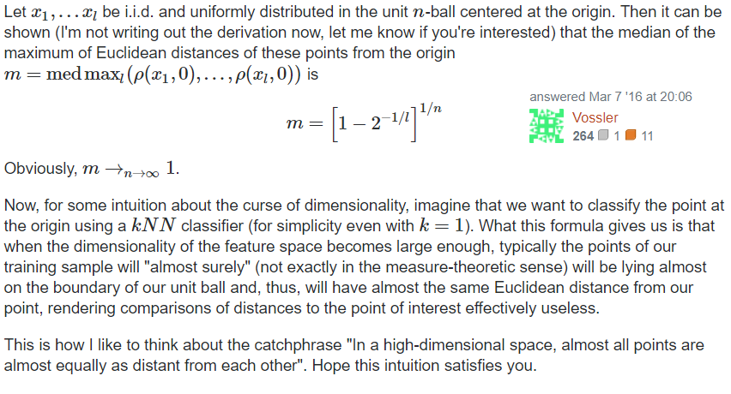
The curse of dimensionality

Slide 7
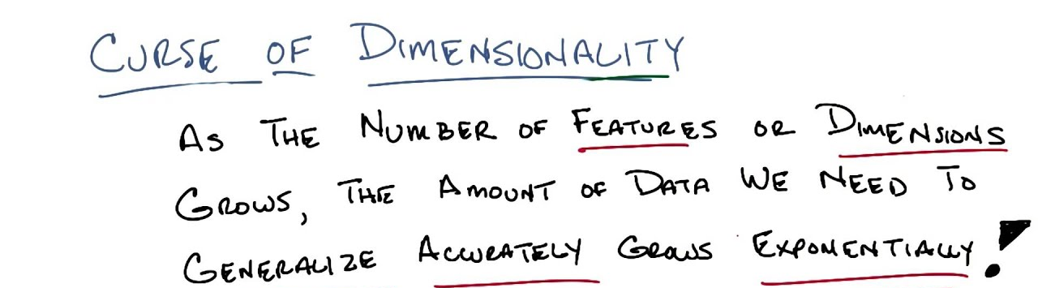
The curse of dimensionality

Slide 8
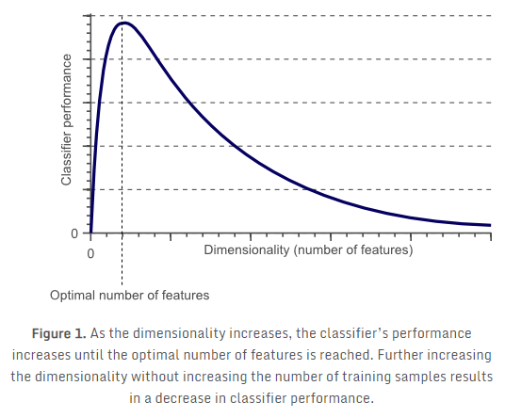
The curse of dimensionality
http://www.visiondummy.com/2014/04/curse-dimensionality-affect-classification/

Slide 9
Breaking the curse
SOLUTION?
Extract only relevant features and thereby reduce dimension!
How?
https://slideplayer.com/slide/5835919/

Slide 10
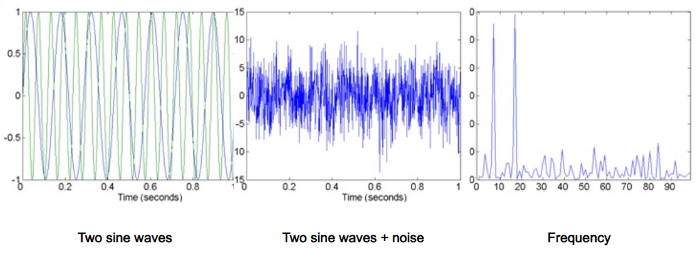
Breaking the curse
FILTERING
https://slideplayer.com/slide/5835919/

Slide 11
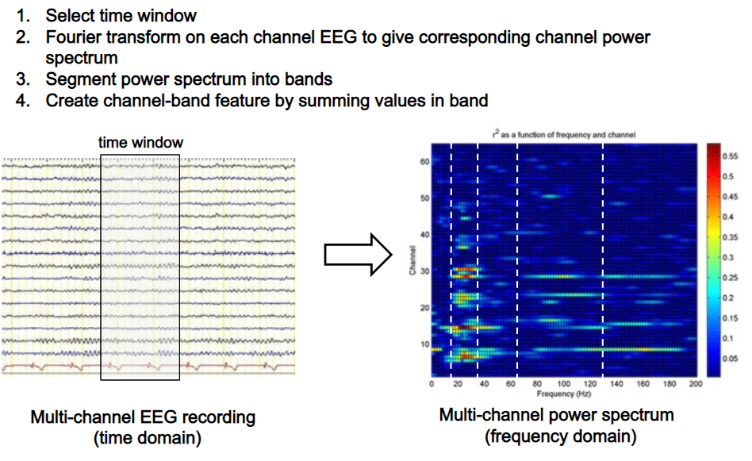
Breaking the curse
FILTERING
https://slideplayer.com/slide/5835919/

Slide 12
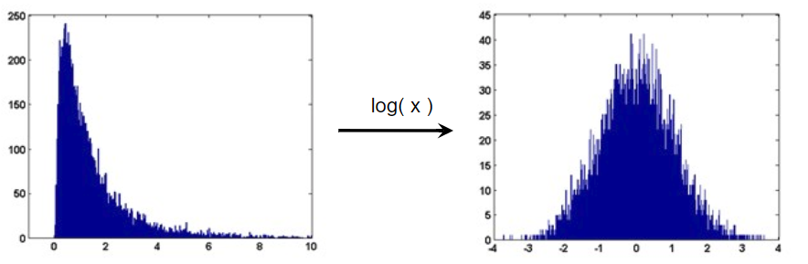
Breaking the curse
TRANSFORMATION
https://slideplayer.com/slide/5835919/

Slide 13
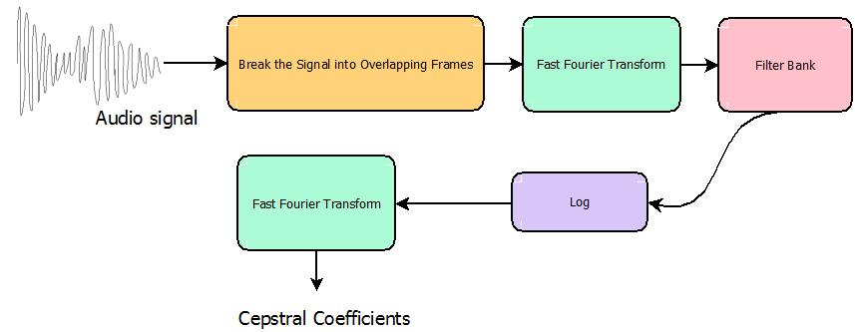
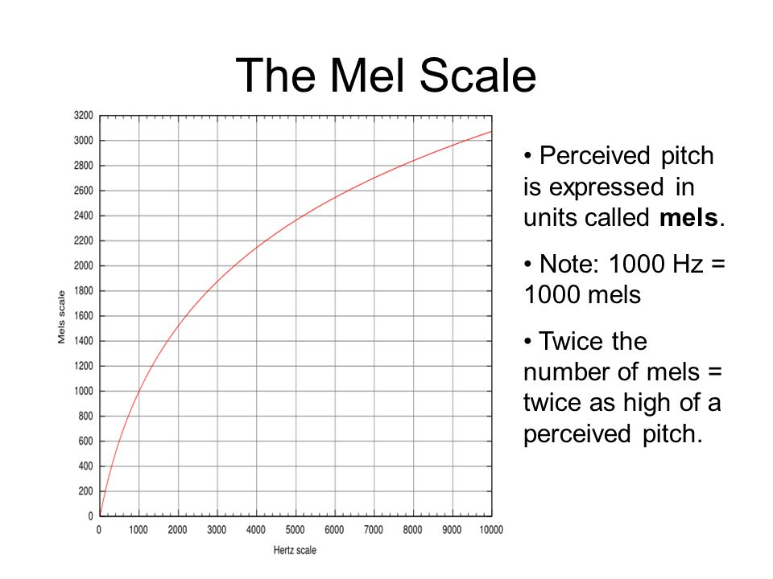
Breaking the curse
FILTERING AND TRANSFORMATION
MEL scale
warping
MEL scale
CEPSTRAL
FEATURE VECTOR
SPEECH
RECOGNITION

Slide 14
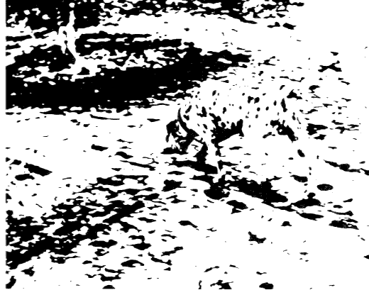
Breaking the curse
FUNDAMENTAL PROBLEM OF FILTERING
What is noise? What is signal?

Slide 15
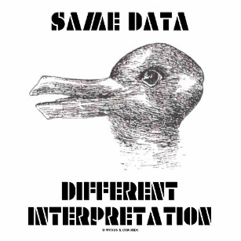
Breaking the curse
FUNDAMENTAL PROBLEM OF FILTERING

Slide 16
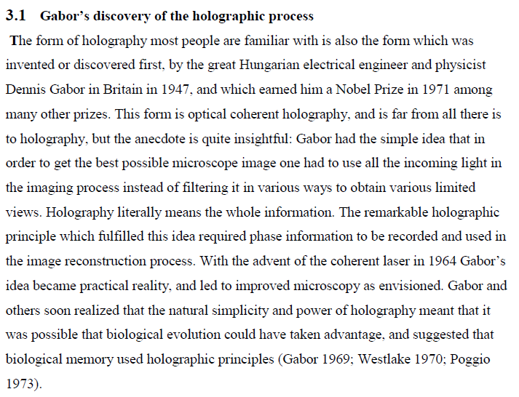
BACK TO the curse
FILTERING?
Kjeldsen 2013

Slide 17
Breaking the curse
SMART FILTERING?

Slide 18
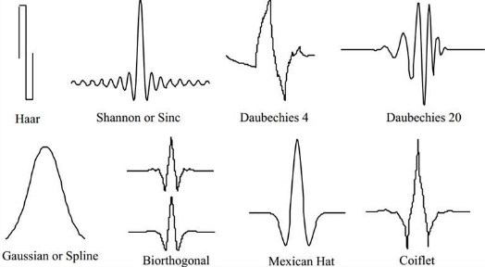
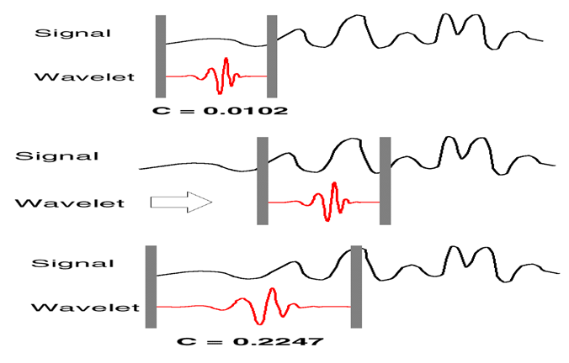
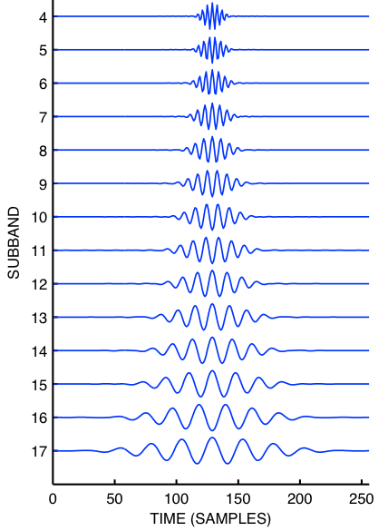
MAKING the curse WORSE
Mother wavelets
WAVELET FILTERING
Daughter wavelets
Scales

Slide 19
MAKING the curse WORSE
Mother wavelets
WAVELET FILTERING
Daughter wavelets
Scales

Slide 20
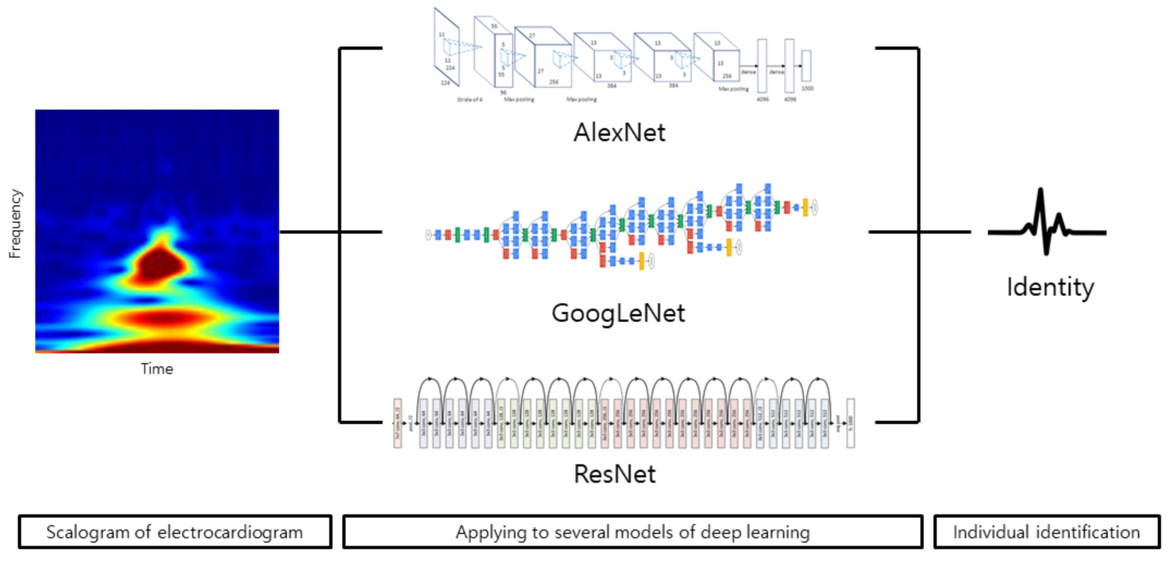
MAKING the curse WORSE
WAVELET FEATURES

Slide 21
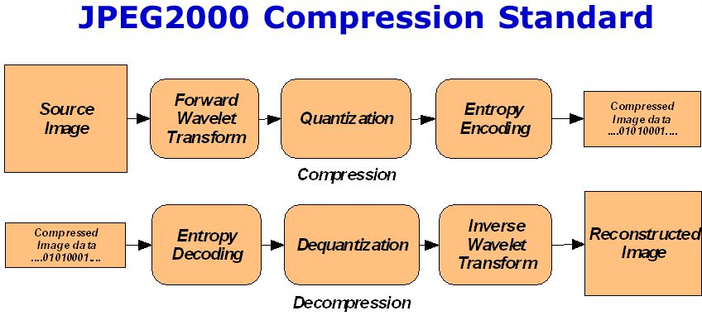
Breaking the curse
WAVELET COMPRESSION

Slide 22
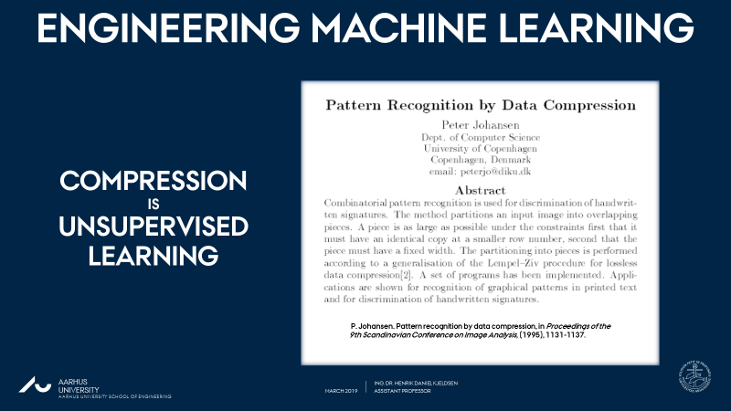
Breaking the curse
SMART FILTERING?
The distinction between dimensionality reduction and machine learning blurs
DIMENSIONALITY REDUCTION
MACHINE
LEARNING
MACHINE
LEARNING
MACHINE
LEARNING

Slide 23

Breaking the curse
PRINCIPAL COMPONENT ANALYSIS
pca.fit
pca.transform
http://www.nlpca.org/pca_principal_component_analysis.html

Slide 24
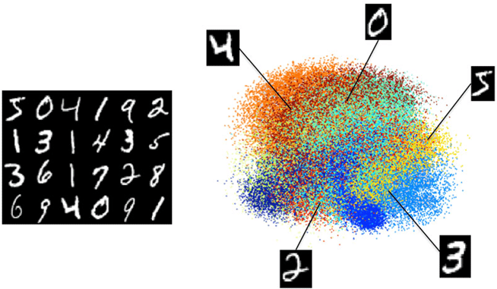
Breaking the curse
PRINCIPAL COMPONENT ANALYSIS
https://www.researchgate.net/figure/Projection-into-a-3D-space-via-PCA-of-the-MNIST-benchmark-dataset-This-data-set_fig3_261567034

Slide 25
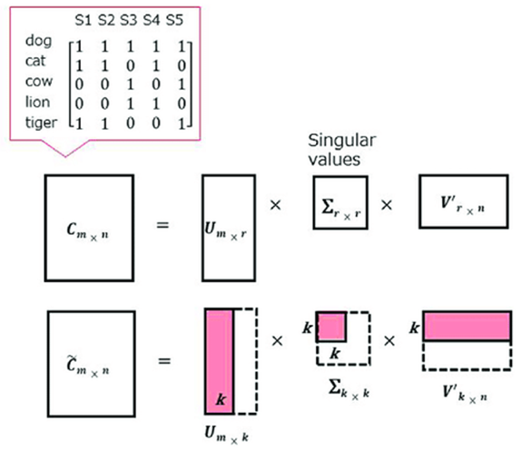
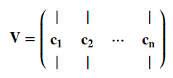
Breaking the curse
PRINCIPAL COMPONENT ANALYSIS VIA SINGULAR VALUE DECOMPOSITION
SVD of C
Principal components
Filtered reconstruction

Slide 26
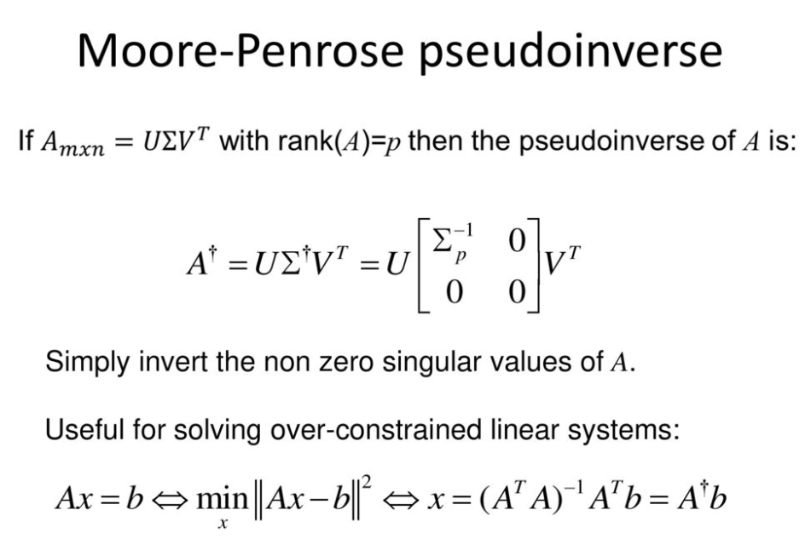
Breaking the curse
https://slideplayer.com/slide/12694737/

Slide 27
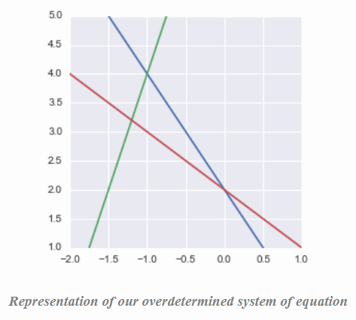
Breaking the curse
https://hadrienj.github.io/posts/Deep-Learning-Book-Series-2.9-The-Moore-Penrose-Pseudoinverse/

Slide 28
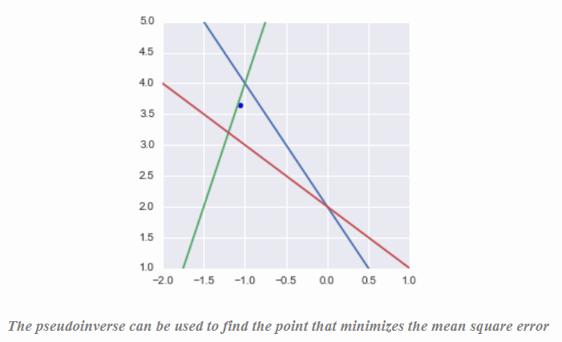
Breaking the curse
https://hadrienj.github.io/posts/Deep-Learning-Book-Series-2.9-The-Moore-Penrose-Pseudoinverse/

Slide 29
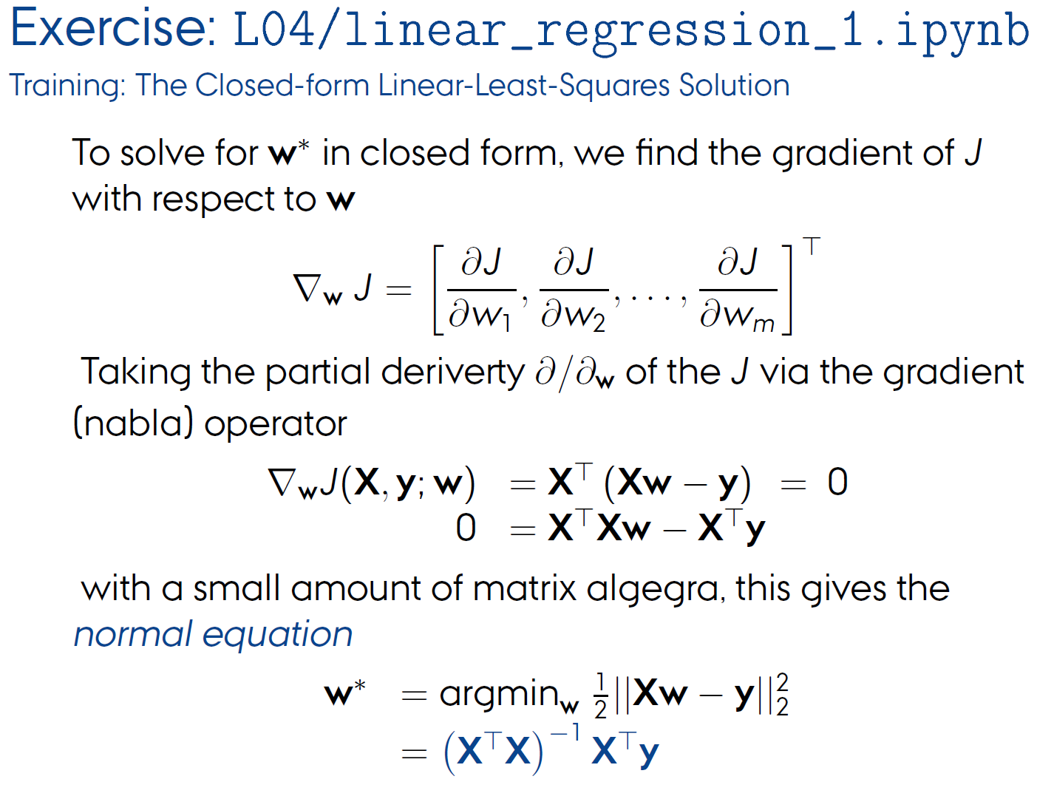
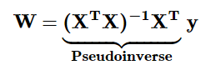
Breaking the curse

Slide 30
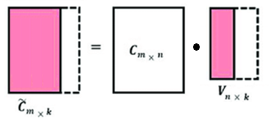
Breaking the curse
PRINCIPAL COMPONENT ANALYSIS VIA SINGULAR VALUE DECOMPOSITION
SVD of C
Principal components
Compressed projection

Slide 31
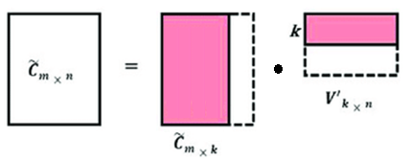
Breaking the curse
PRINCIPAL COMPONENT ANALYSIS VIA SINGULAR VALUE DECOMPOSITION
SVD of C
Principal components
Decompressed reconstruction

Slide 32
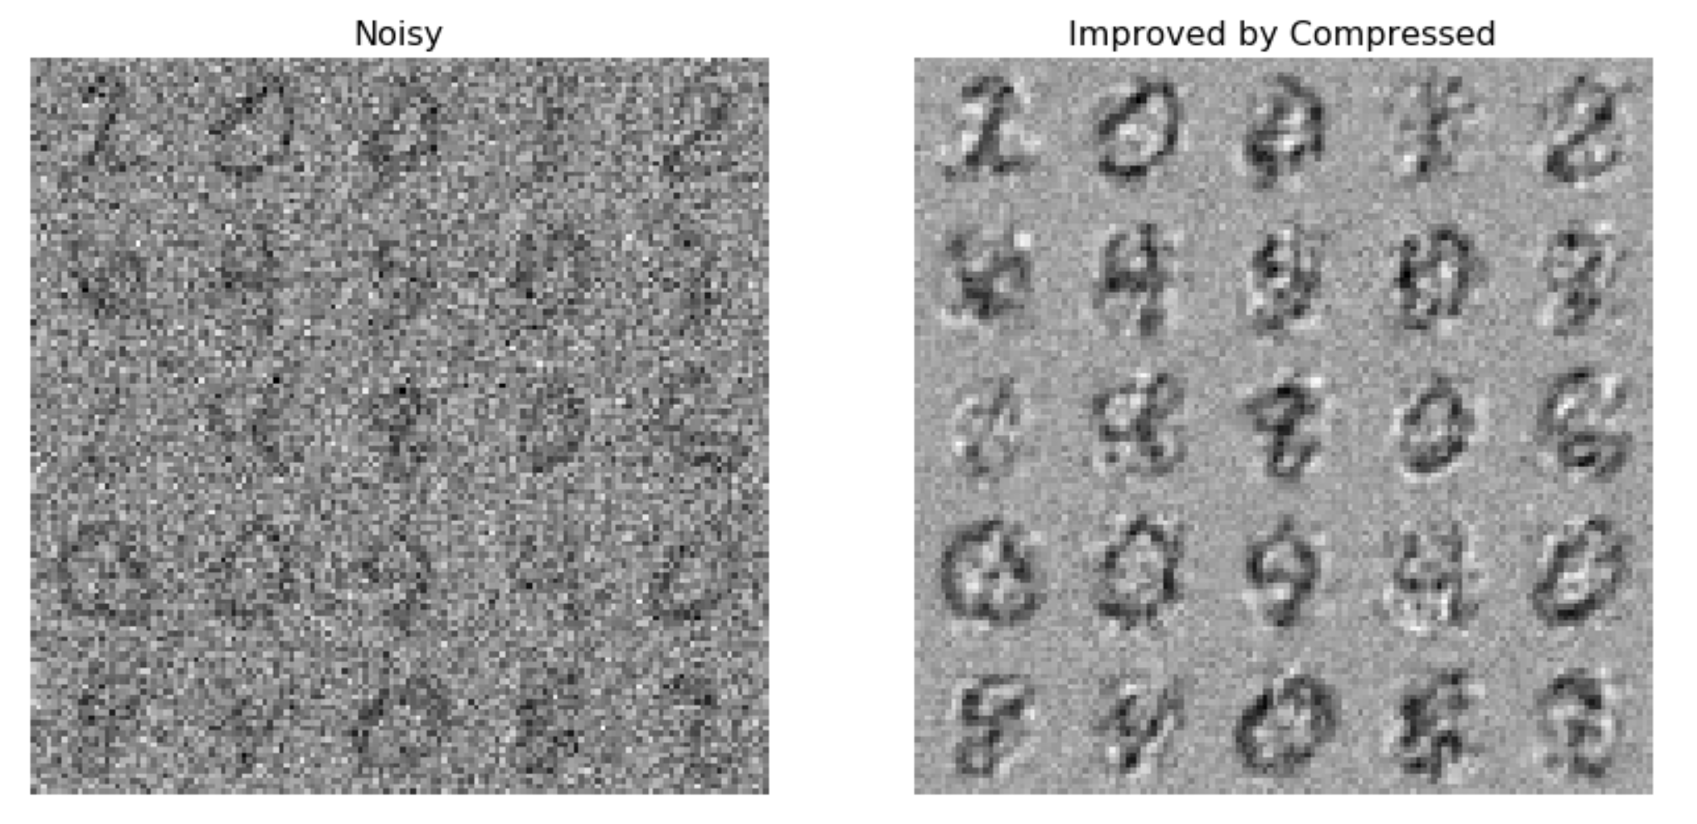
Breaking the curse
PRINCIPAL COMPONENT ANALYSIS VIA SINGULAR VALUE DECOMPOSITION
SVD of C
Principal components
Decompressed reconstruction

Slide 33
Breaking the curse
PRINCIPAL COMPONENT ANALYSIS VIA SINGULAR VALUE DECOMPOSITION

Slide 34
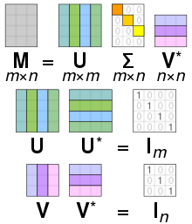
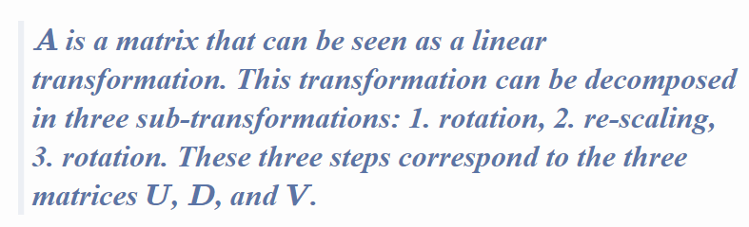
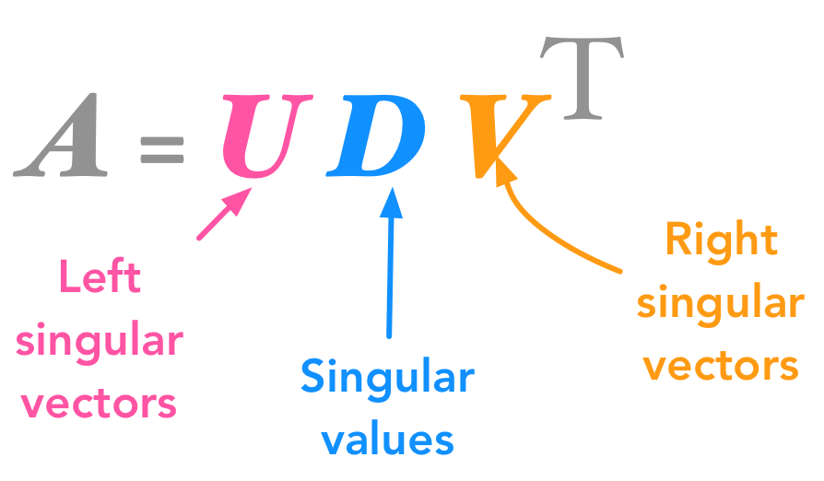
Breaking the curse
https://hadrienj.github.io/posts/Deep-Learning-Book-Series-2.8-Singular-Value-Decomposition/

Slide 35
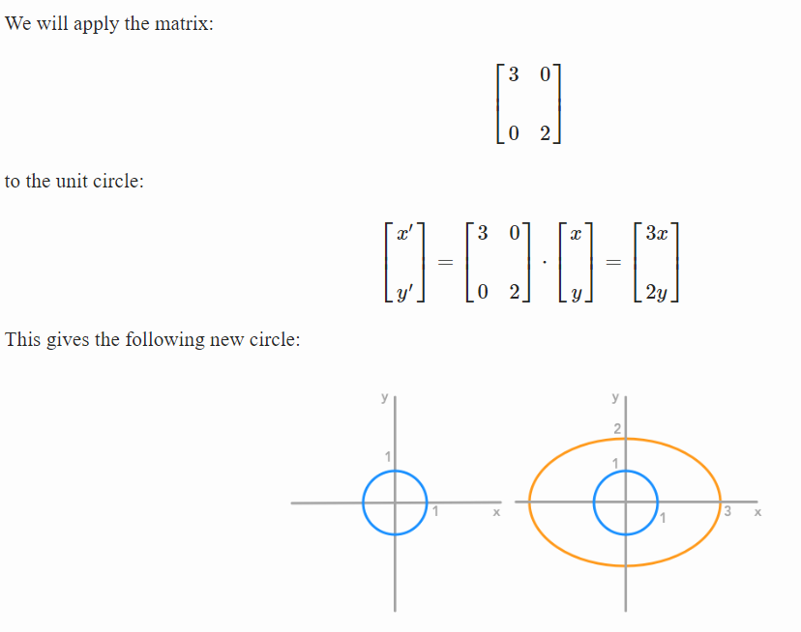
Breaking the curse
https://hadrienj.github.io/posts/Deep-Learning-Book-Series-2.8-Singular-Value-Decomposition/

Slide 36
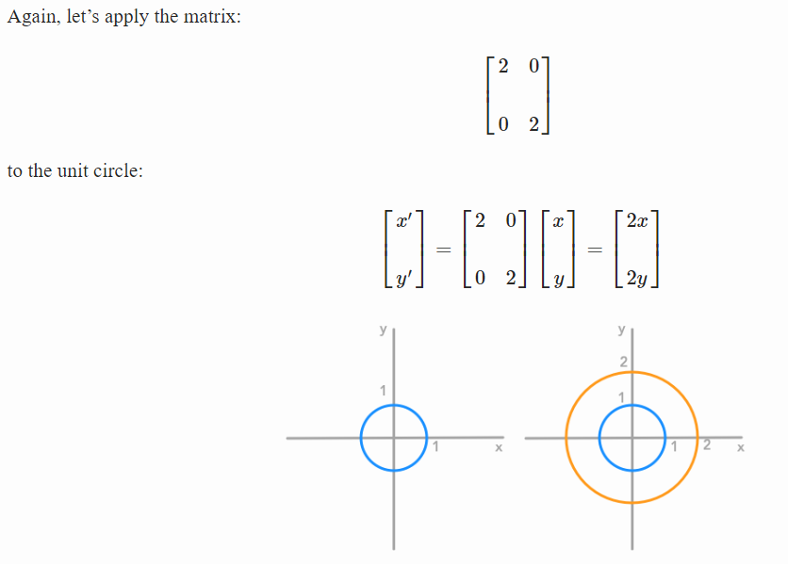
Breaking the curse
https://hadrienj.github.io/posts/Deep-Learning-Book-Series-2.8-Singular-Value-Decomposition/

Slide 37
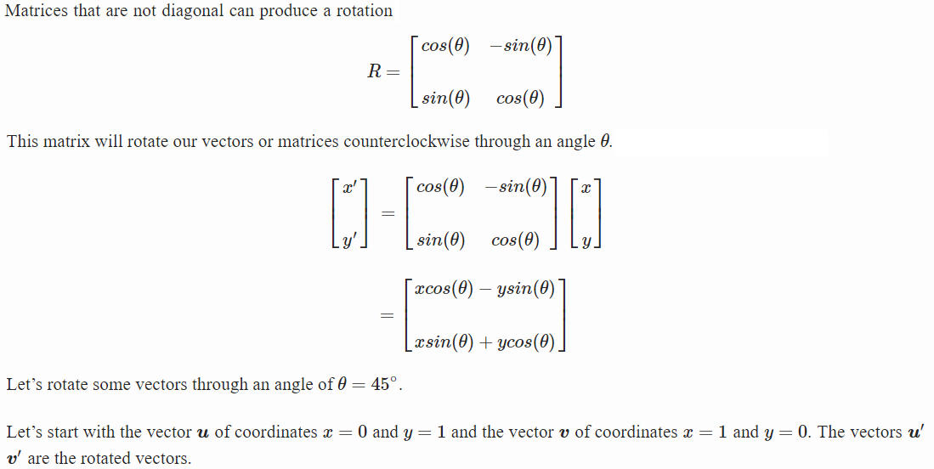
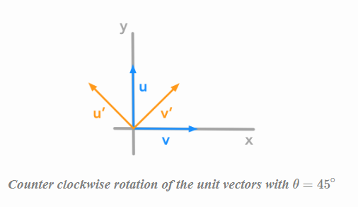
Breaking the curse
https://hadrienj.github.io/posts/Deep-Learning-Book-Series-2.8-Singular-Value-Decomposition/

Slide 38
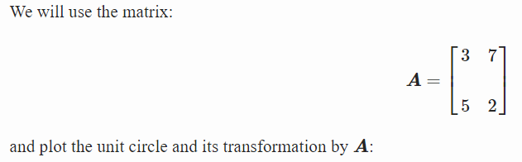
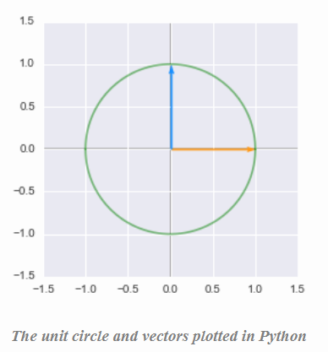
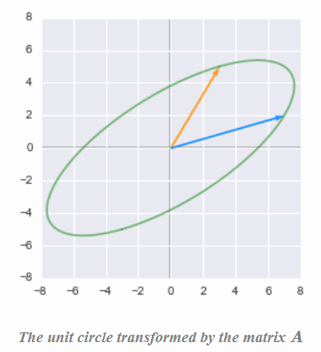
Breaking the curse
https://hadrienj.github.io/posts/Deep-Learning-Book-Series-2.8-Singular-Value-Decomposition/

Slide 39
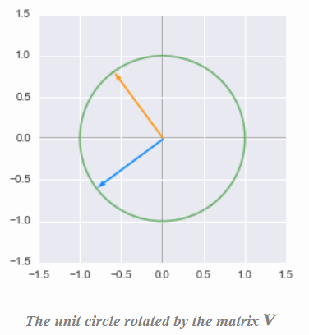
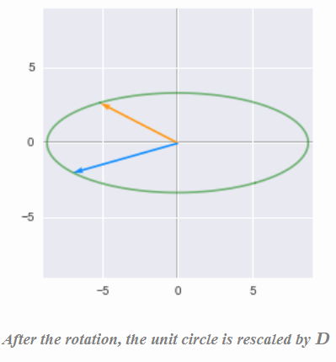
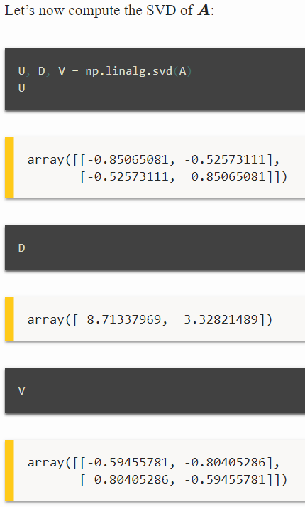
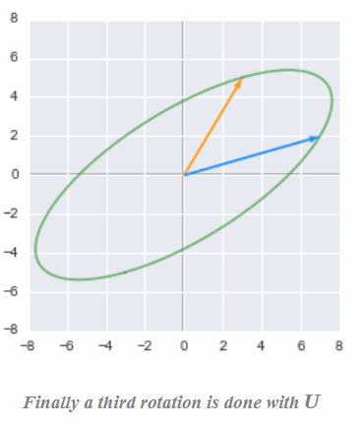
Breaking the curse
https://hadrienj.github.io/posts/Deep-Learning-Book-Series-2.8-Singular-Value-Decomposition/

Slide 40
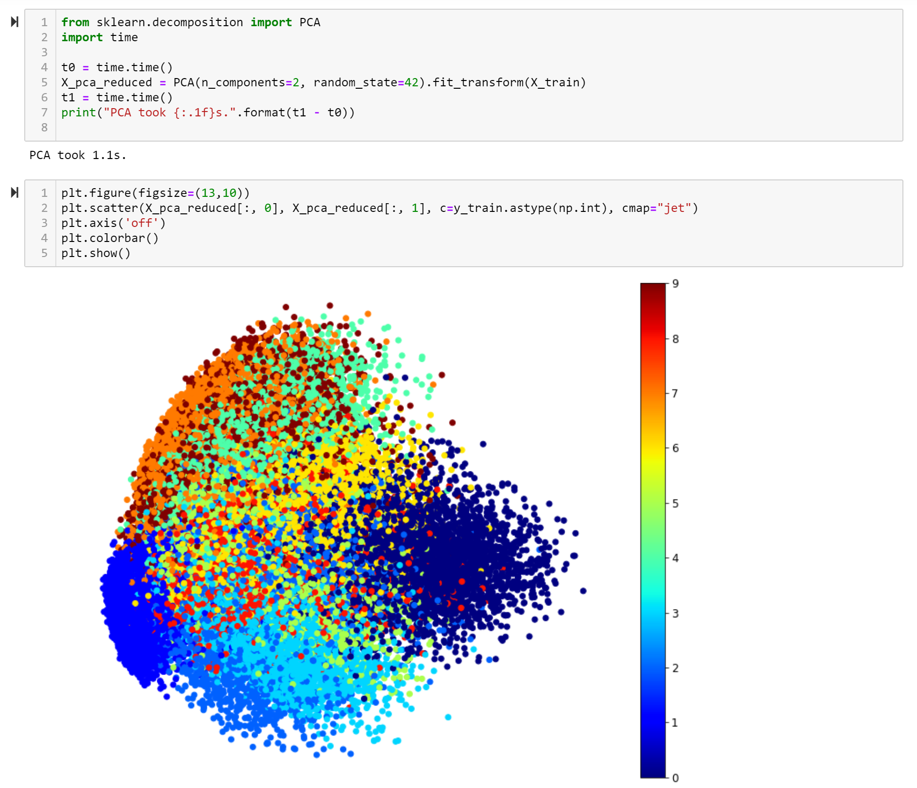
Breaking the curse
OTHER FEATURES
EXTRACTORS

Slide 41
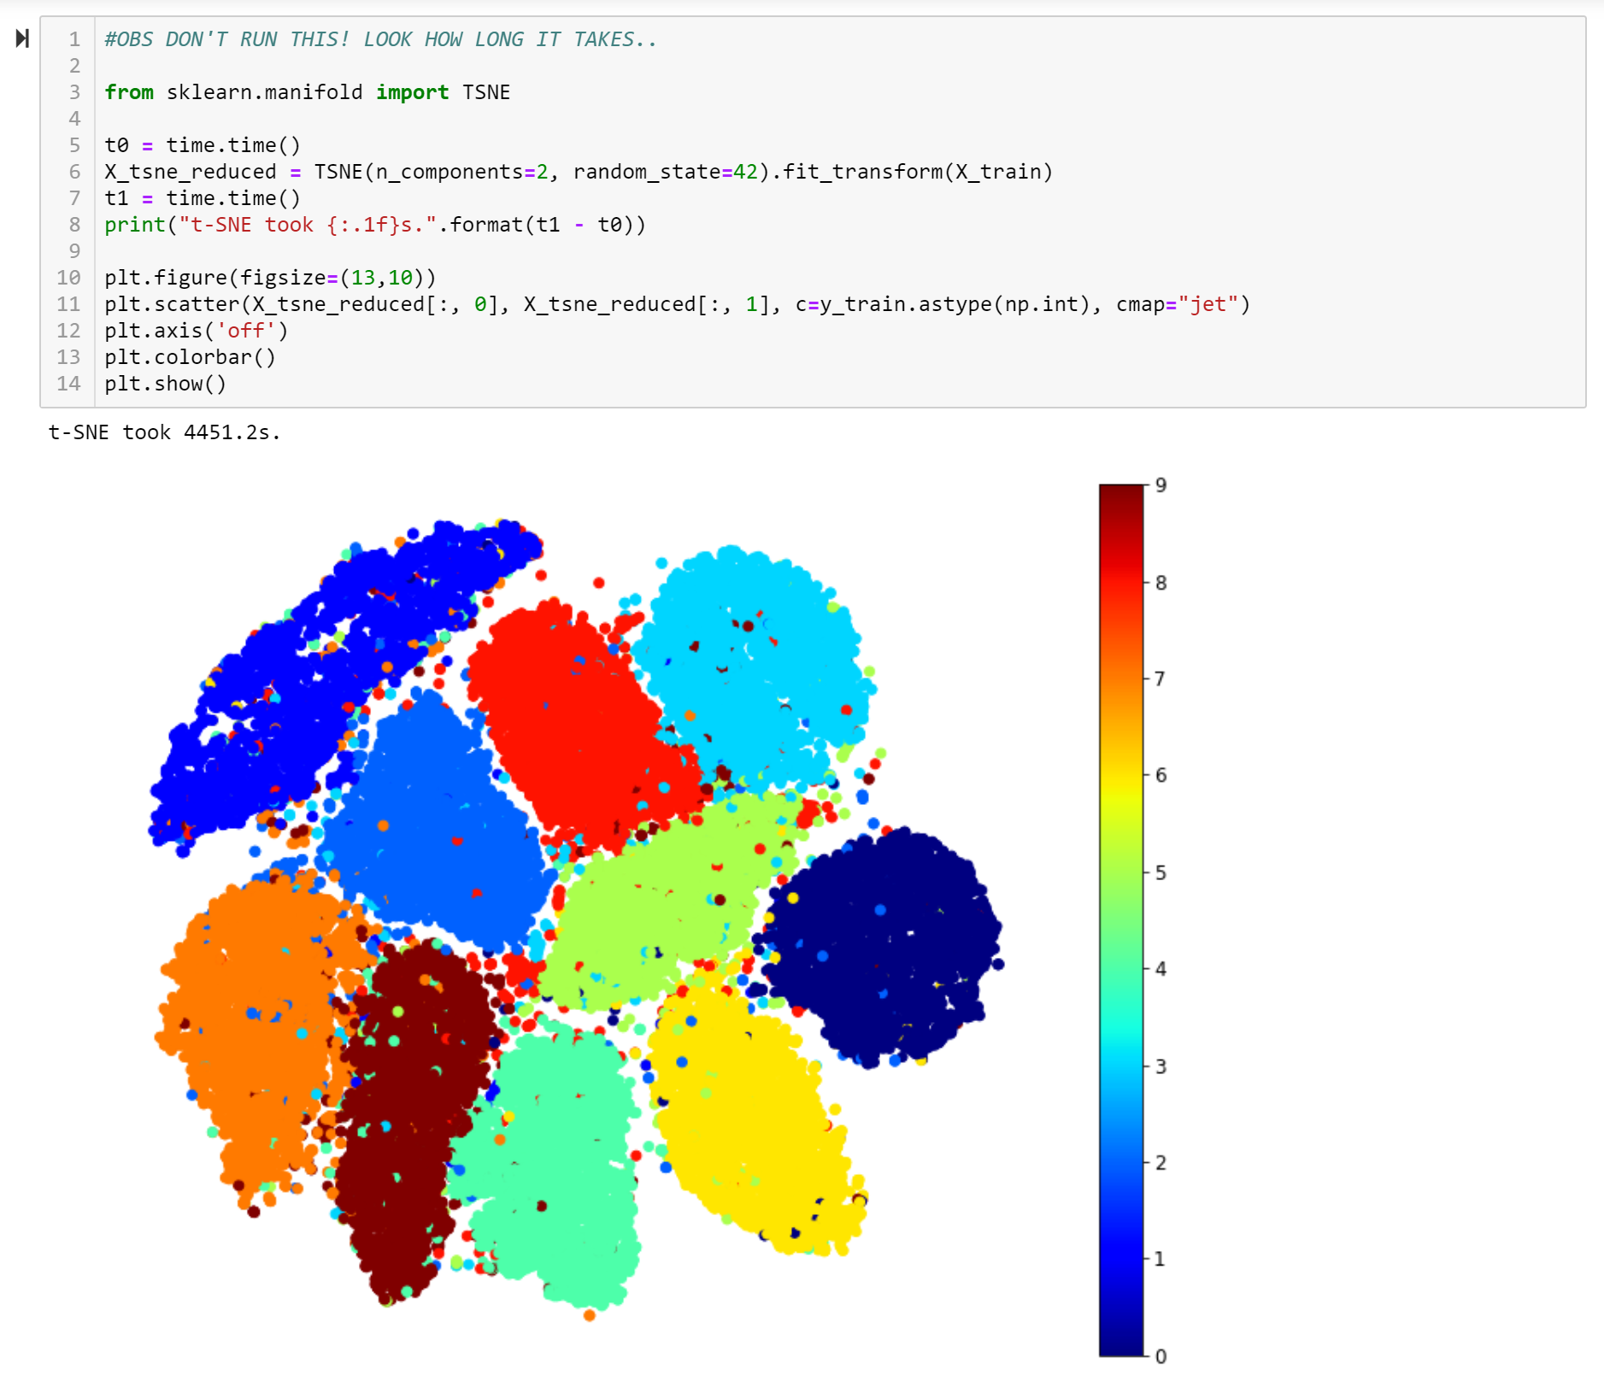
Breaking the curse
OTHER FEATURES
EXTRACTORS

Slide 42
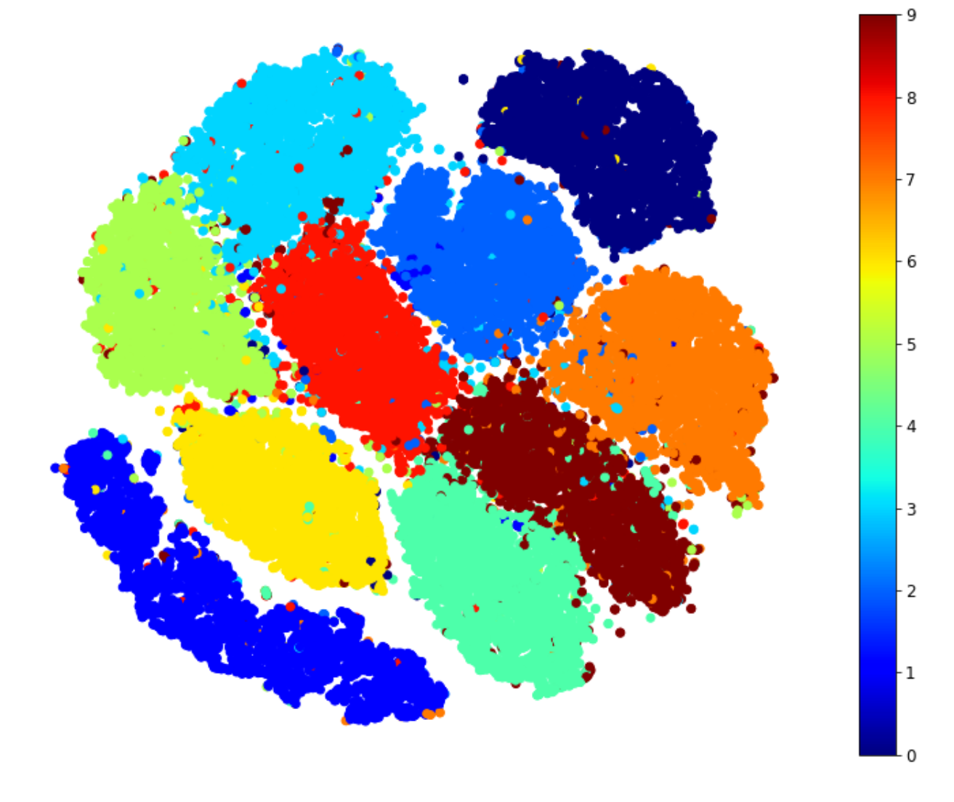
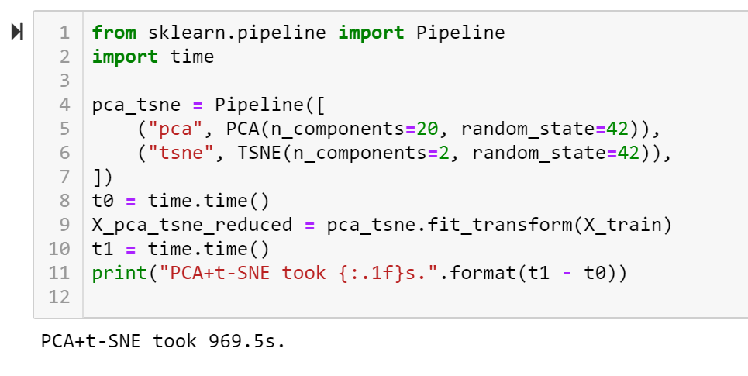
Breaking the curse
OTHER FEATURES
EXTRACTORS

Slide 43

the Blessing OF DIMENSIONALITY
ENGINEERING MACHINE LEARNING
HEALTH TECHNOLOGY

Slide 44


SPARSE METHODS
HOLOGRAPHIC MEMORY
(simulated on a quantum computer
simulated on a Turing machine)
Kjeldsen 2013

Slide 45


COMPRESSIVE SENSING
https://nuit-blanche.blogspot.com/p/teaching-compressed-sensing.html

Slide 46


COMPRESSIVE SENSING
https://nuit-blanche.blogspot.com/p/teaching-compressed-sensing.html

Slide 47

COMPRESSIVE SENSING
https://nuit-blanche.blogspot.com/p/teaching-compressed-sensing.html

Slide 48

COMPRESSIVE SENSING
10 equations, 50 unknowns
Only 2 values different from 0
https://nuit-blanche.blogspot.com/2011/09/mirror-mirror-whos-sparsest-of-them-all.html

Slide 49

COMPRESSIVE SENSING
10 equations, 50 unknowns
Only 2 values different from 0
https://nuit-blanche.blogspot.com/2011/11/how-to-wow-your-friends-in-high-places.html

Slide 50

COMPRESSIVE SENSING
10 equations, 50 unknowns
Only 2 values different from 0
https://nuit-blanche.blogspot.com/2011/09/mirror-mirror-whos-sparsest-of-them-all.html

Slide 51




COMPRESSIVE SENSING
INTERESTING NP ≈ P TREND
L0 minimization is intractable (NP)
L1 is just hard (P)
Compressive sensing:
L1 = L0 under certain conditions
https://nuit-blanche.blogspot.com/2011/09/mirror-mirror-whos-sparsest-of-them-all.html

Slide 52

COMPRESSIVE SENSING
THE KERNEL TRICK + COMPRESSIVE SENSING
http://ecee.colorado.edu/~smhughes/QiHughesKernelTrickinCompressiveSensing.pdf

Slide 53

TensorS
https://www.slideshare.net/BertonEarnshaw/a-brief-survey-of-tensors

Slide 54
TensorS
http://tensorlab.cms.caltech.edu/users/anima/slides/SIAM2019.pdf

Slide 55





TensorS

Slide 56




Tensor compression
https://slideplayer.com/slide/5338124/

Slide 57


Tensor decomposition

Slide 58

Tensor COMPRESSION

Slide 59

Tensor COMPRESSION

Slide 60
Tensor Decomposition TRAINING

Slide 61
Tensor Decomposition TRAINING

Slide 62

Tensor LEARNING

Slide 63


Tensor LEARNING
http://jeankossaifi.com/blog/rpca.html

Slide 64

Tensor LEARNING
http://jeankossaifi.com/blog/rpca.html

Slide 65

Tensor LEARNING
http://jeankossaifi.com/blog/rpca.html

